Slide 1
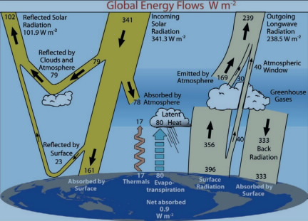


Radiative balance – adjusted back to pre-industrial times
$$σT^{4}$$
168
313

